Slide 1
DV1C04 Deployt & Monitoring in DevOps
L04
Challenges in DevOps Deploy

Slide 2
Learning Objectives
Describe task flows within Deploy Phase

Slide 3
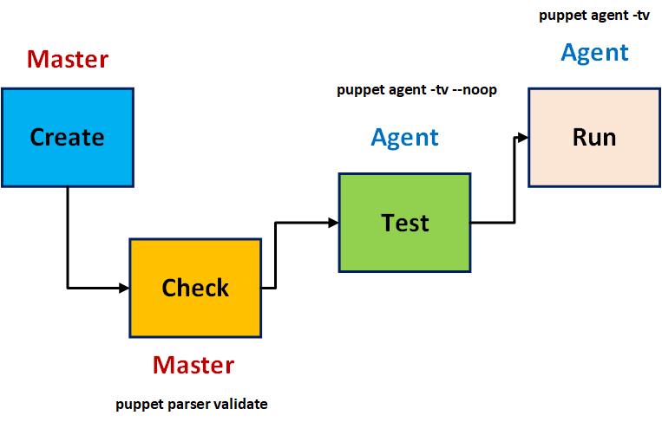
Code Creation Process

Slide 4
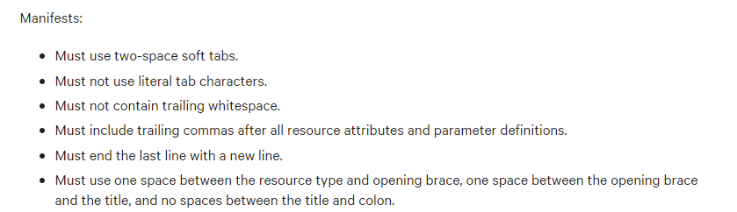
Module design practices
Module manifests should adhere to standard spacing, indentation, and whitespace guidelines.
Source: https://puppet.com/docs/puppet/7/style_guide.html

Slide 5
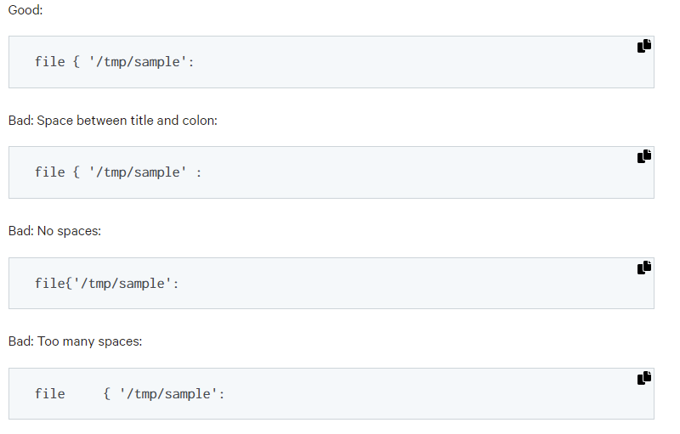
Module design practices
Examples:
Source: https://puppet.com/docs/puppet/7/style_guide.html

Slide 6
Node Definition
A node definition, also known as a node statement, is a block of Puppet code that is contained exclusively in matching nodes' catalogs.
This allows you to assign specific configurations to certain nodes.
Put node definitions in the main manifest, which might be a single site.pp file or a directory with several files.

Slide 7
Node Definition
Any puppet code that is outside of node definition will affect every node.
It means that a node will receive the codes from inside and outside of node definition.
Node definitions are an optional feature of Puppet.

Slide 8
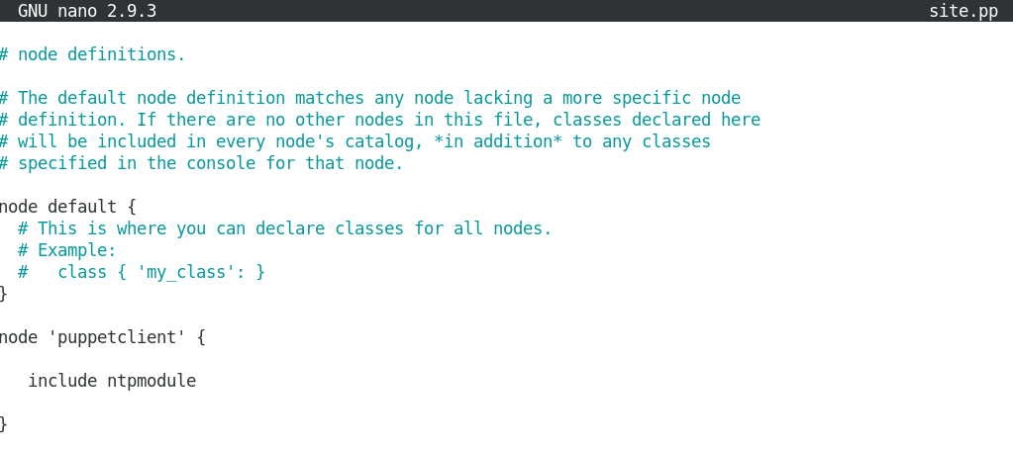
Node Definition
Single node definition

Slide 9
Node Definition
Single node definition

Slide 10
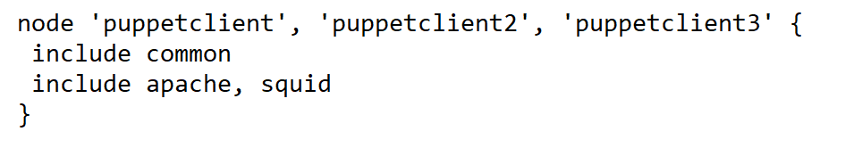
Node Definition
Use a comma-separated list of names to match a group of nodes with a single node definition.

Slide 11

Code Management for Puppet Codes
Version control is used in code management to track, maintain, and deploy Puppet code and data.
The control repository (or repo) is a Git repository used by code management to manage your infrastructure's environments.

Slide 12
Code Management for Puppet Codes
Code management keeps each of your environments up to date when you update code and data in your control repository.
On the primary server, environments are created under /etc/puppetlabs/code/environments.

Slide 13
Code Management for Puppet Codes
Based on the Puppet control repository template, you can establish a control repository with the standard recommended structure, code examples, and configuration scripts.
A control repository comprises:
A Git remote repository.
A default branch named production
A Puppetfile to manage your environment content.
An environment.conf file that modifies the $modulepath setting to allow environment-specific modules and settings.

Slide 14
Code Management for Puppet Codes
Step 1 - Generate a private SSH key to allow access to the control repository.
ssh-keygen -t rsa -b 2048 -P '' -f /etc/puppetlabs/puppetserver/ssh/id-control_repo.rsa
puppet infrastructure configure
Source: https://puppet.com/docs/pe/2021.1/control_repo.html

Slide 15
Code Management for Puppet Codes
Step 2 - Create a repository in your Git account, with the name you want your control repo to have.
Step 3 - Install Git on primary server.
yum install git
Step 4 - Clone the Puppet control-repo template.
git clone https://github.com/puppetlabs/control-repo.git
Source: https://puppet.com/docs/pe/2021.1/control_repo.html

Slide 16
Code Management for Puppet Codes
Step 5 - Change directory into your contro repo.
cd <NAME OF YOUR CONTROL REPO>
Step 6 - Remove the template repository as your default source.
git remote remove origin
Source: https://puppet.com/docs/pe/2021.1/control_repo.html

Slide 17
Code Management for Puppet Codes
Step 7 - Add the control repository you created as the default source.
git remote add origin <URL OF YOUR GIT REPOSITORY>
Step 8 - Push the contents of the cloned control repo to your remote copy of the control repo:
git push origin production
Source: https://puppet.com/docs/pe/2021.1/control_repo.html

Slide 18
Puppet Automates Managing Docker Container
Puppet can help you overcome two issues with massive Docker workflows:
Issue ONE
You have a Puppet code base and are putting some of your services into containers.
How Puppet helps
You may reduce duplication of effort and take advantage of work you've already done by sharing the same code throughout your infrastructure, regardless of whether it uses containers or not.

Slide 19
Puppet Automates Managing Docker Container
Puppet can help you overcome two issues with massive Docker workflows:
Issue TWO
You created a lot of images, but growing Dockerfiles requires either a complicated image hierarchy or copying and pasting snippets between multiple Dockerfiles.
How Puppet helps
The image build Puppet module provides you a rich domain-specific language for declarative image composition.

Slide 20
Challenges in DevOps Deploy
When a DevOps environment relies on cloud infrastructure and deployments, the application is frequently vulnerable to possible security vulnerabilities if suitable security controls are not implemented.
In the DevOps context, several open-source, immature, and innovative tools are used.
Containers are ultra-compact, portable packaging platforms that make deploying applications a breeze. Unfortunately, determining the security of these containers can be difficult for security teams.
Source: https://www.cypressdatadefense.com/blog/devops-challenges-and-solutions/

Slide 21
Challenges in DevOps Deploy
Containers are ultra-compact, portable packaging platforms that make deploying applications a breeze. Unfortunately, determining the security of these containers can be difficult for security teams.
But the problem is not limited to containers. All of the tools used in the deployment process must be addressed and protected, as they are critical in the creation of the deployed application and environment.
Source: https://www.cypressdatadefense.com/blog/devops-challenges-and-solutions/

Slide 22
Challenges in DevOps Deploy
Secret management and stringent access constraints are critical in highly automated builds and deployments.
Source: https://www.cypressdatadefense.com/blog/devops-challenges-and-solutions/

Slide 23
References
https://puppet.com/docs/puppet/7/style_guide.html
https://puppet.com/docs/pe/2021.1/control_repo.html
https://puppet.com/blog/building-docker-images-puppet/
https://www.cypressdatadefense.com/blog/devops-challenges-and-solutions/

Slide 24
Thank you

